Slide 1
Machine Learning – Diving Deeper
Srini Karlekar – Multifamily architecture

Slide 2
Machine learning
A gentle introduction

Slide 3
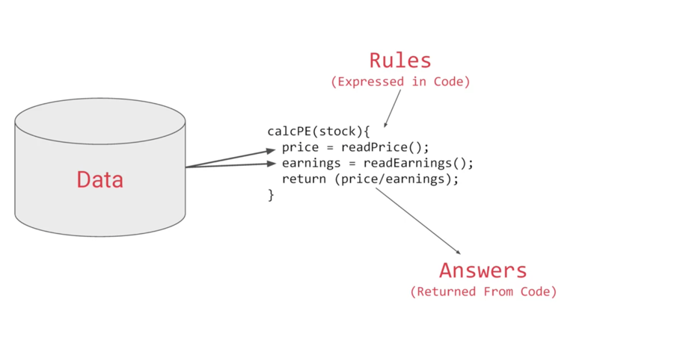
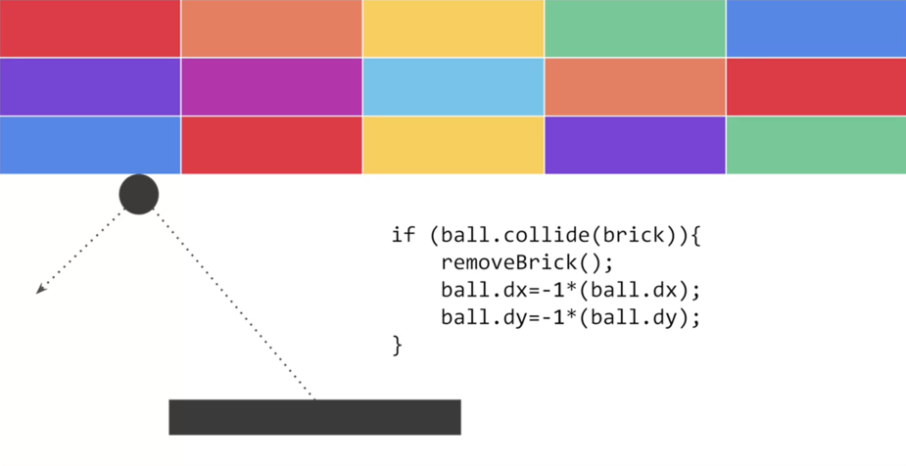
Traditional Programming - Examples
Stock Analytics
Gaming

Slide 4
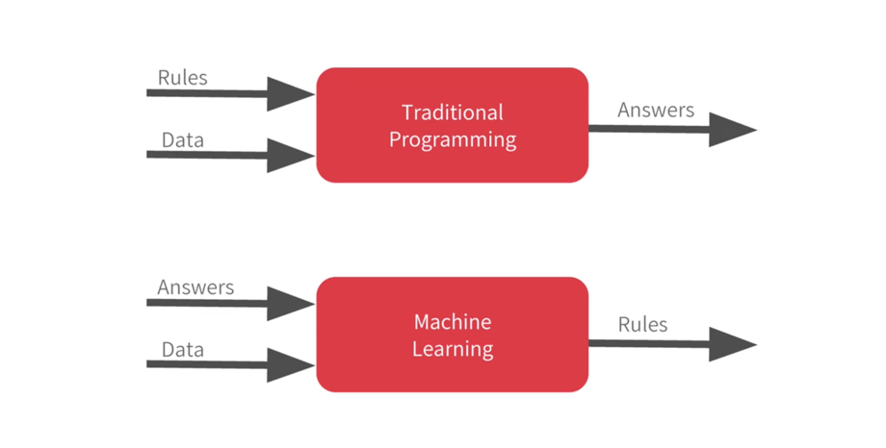
Traditional Programming vs machine learning

Slide 5
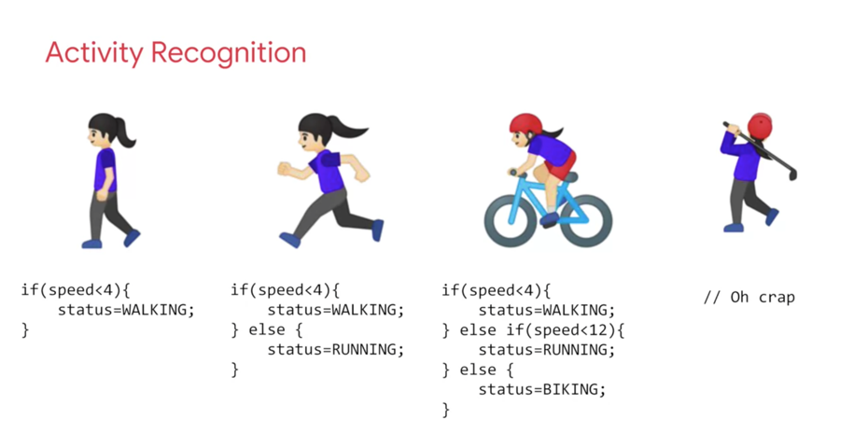
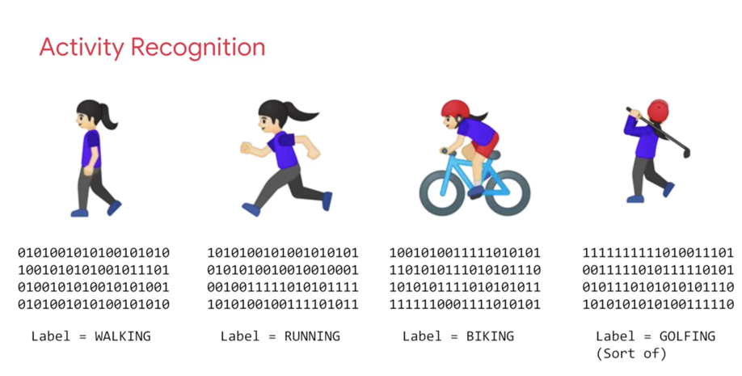
Applicability of machine learning

Slide 6
deep learning
Neural Networks

Slide 7
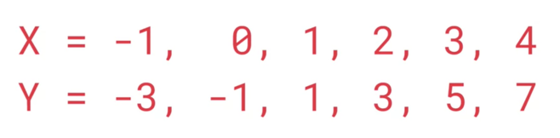
Can you figure out the formula?
y=2x-1

Slide 8
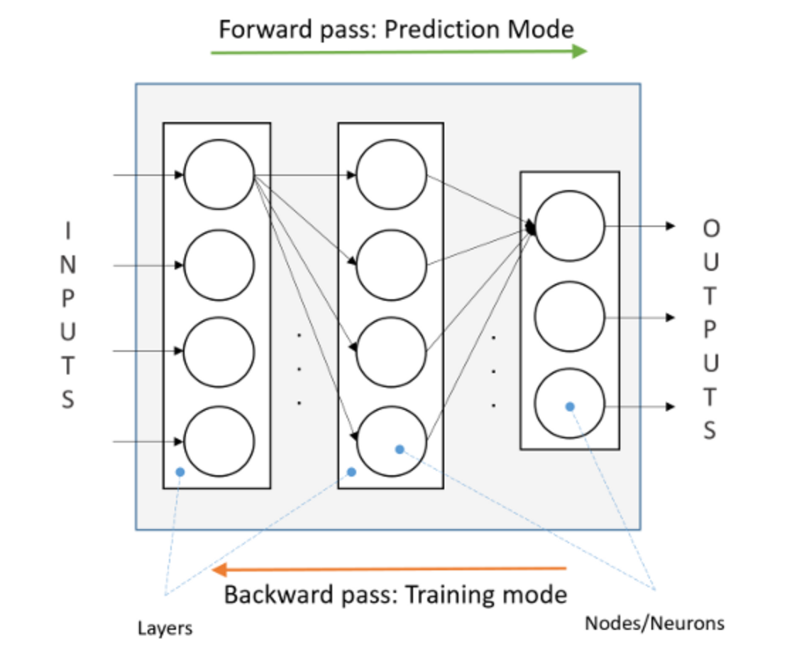
Feed Forward Neural network
Feed Forward Neural Network is a network of simple state machines called neurons or nodes which receive input, change their internal state according to that input and an associated weight to produce an output.
The nodes are grouped together in a ordered sequence of so called layers, and each node in layer is connected to all nodes in the next layer. Each node performs calculation which takes input from all nodes from previous layer.
Neural Nets has two modes of operation: training and prediction mode. In the training mode the network adjusts internal weights in order to minimize prediction error. In the prediction mode the trained network attempts to predict output for the given input.
One of the most striking facts about neural networks is that they can approximate any function given enough time and/or training data – universality theorem of neural networks

Slide 9
the network learns using loss functions & optimizers
A neural network learns by trial and error. It starts with a guess and checks the answer using the loss function. The error/loss function tells the neural network how far out its result is from the actual result based on the training data. The lower the loss, the closer the answer is to the actual result. By iterating over the training data and over again till the loss is smaller, the network learns the right answer.
The mathematical procedure for finding the minimum of the error/loss function is known as the optimization method or optimizer.

Slide 10
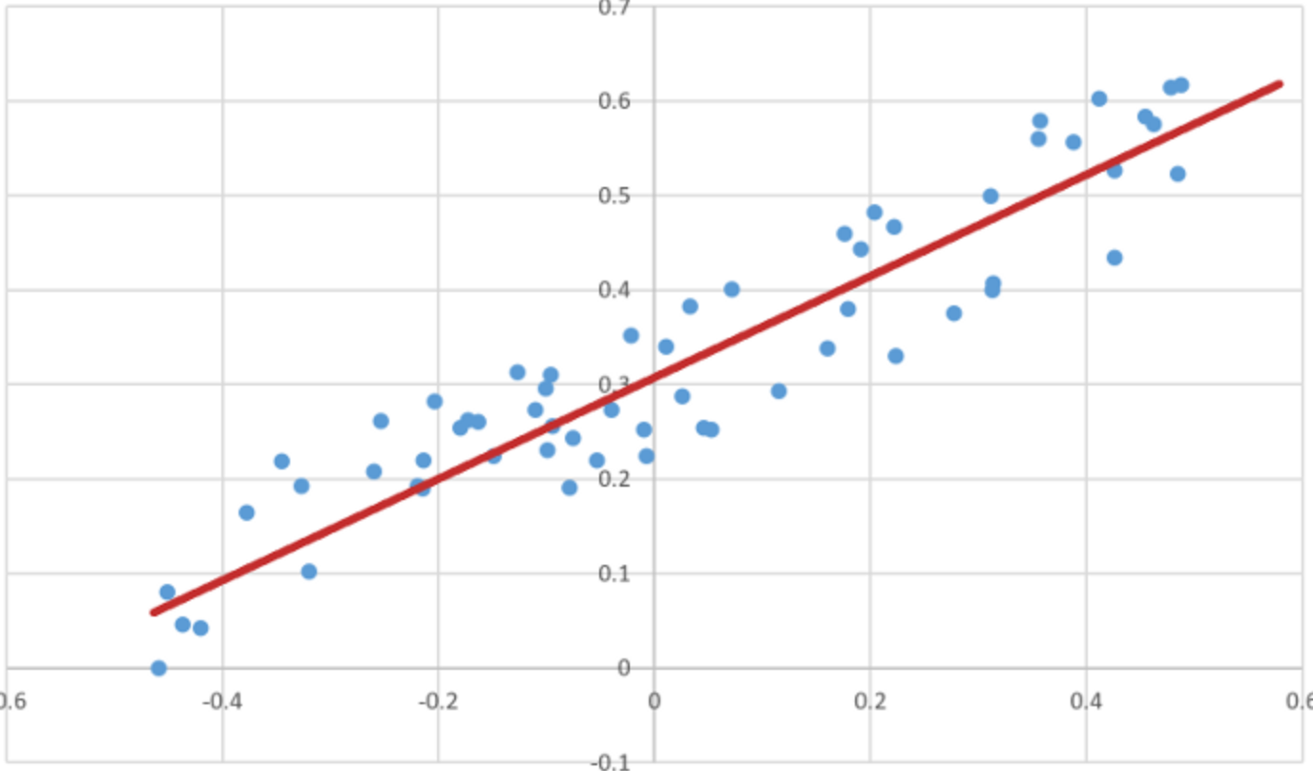
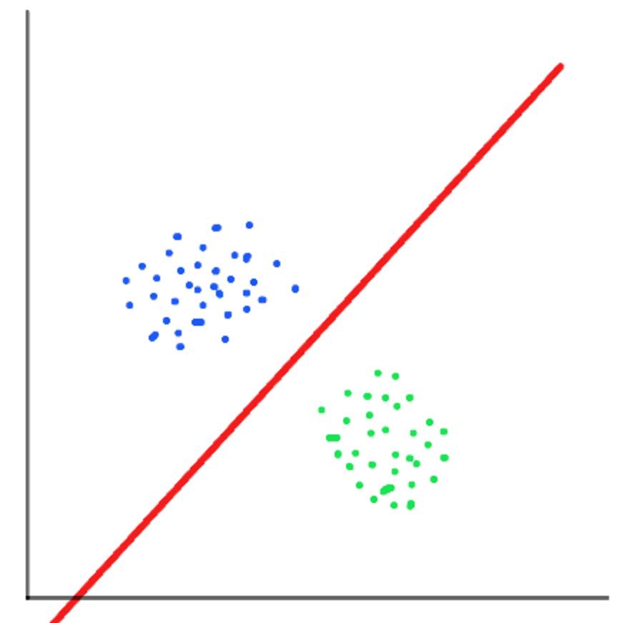
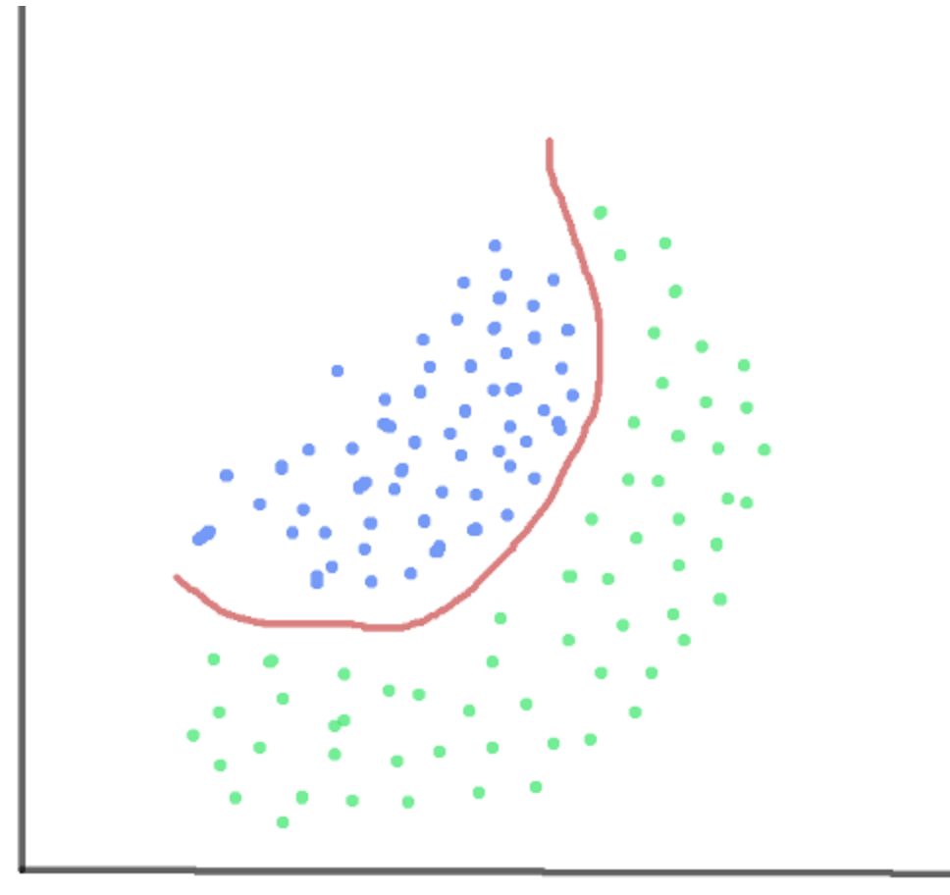
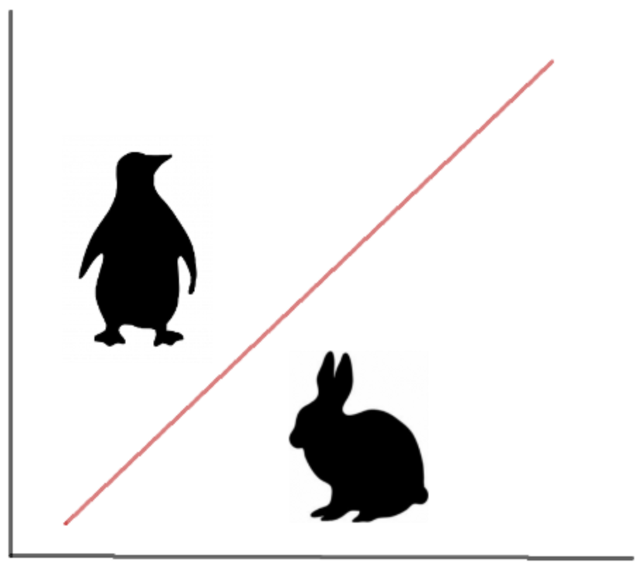
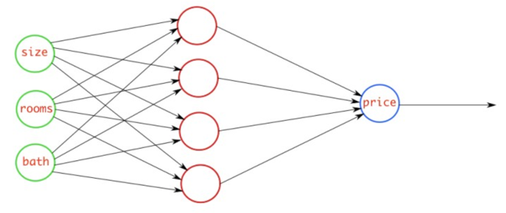
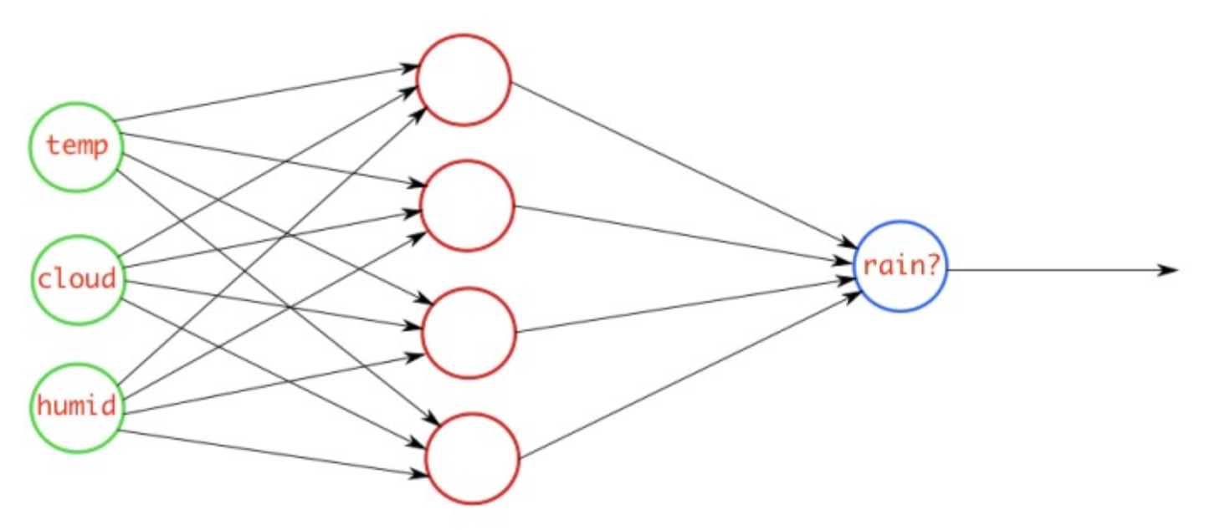
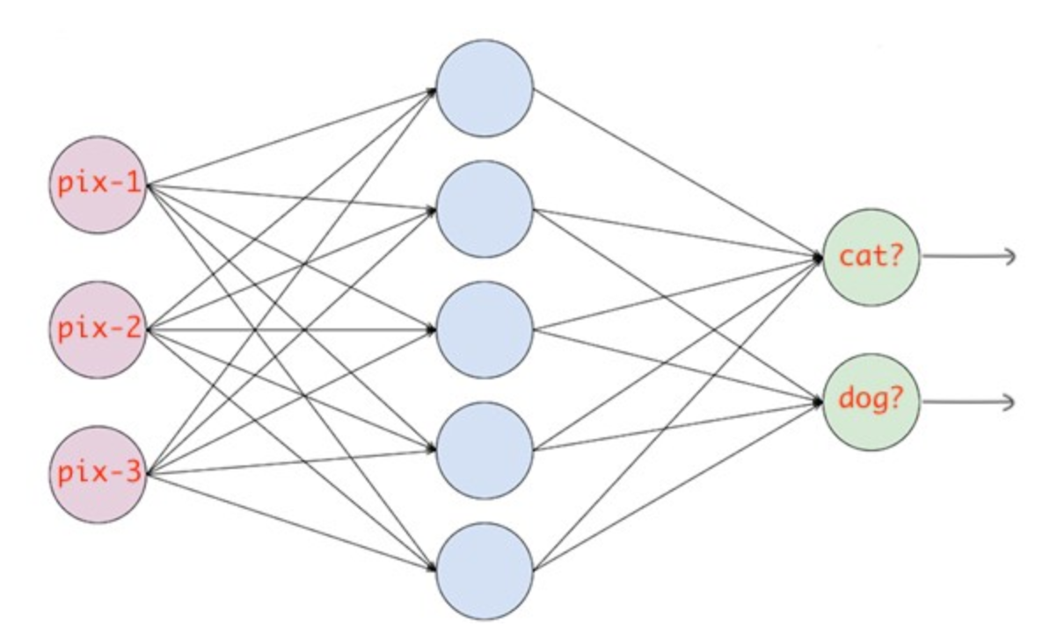
Understanding loss functions for neural nets
Mean Squared Error (MSE) – Mainly used for linear regression tasks where the output is a real number, this loss function uses the mean of squared differences between actual values and predicted values.
Binary Cross Entropy (BCE) – Mainly used for logistic regression or binary classification tasks when you want the neural network to classify the data into two classes (0 or 1) using Sigmoid function.
Categorical Cross Entropy (CCE) – Mainly used for multi-class classification tasks when you want the neural network to classify the data into multiple classes using Softmax function.
Predicting house prices based on property attributes
Predicting rain based on other measurable weather conditions
Predicting type of animal using images
Notes:
Linear Regression Linear regression is a very basic type of supervised machine learning, which tries to find the best possible straight line to describe main trend in underlying training data. Starting from some random position, it adjusts/moves the line until it finds the position that gives the minimum total average distance of data points from the line. It uses MEAN SQUARED ERROR (MSE) as a loss function and STOCHASTIC GRADIENT DESCENT (SGD) as an optimization algorithm. Stochastic gradient descent optimization method knows how to move line into direction which will likely lower the error. In its basic form, for one input x, and one output y, the model of this algorithm is basic mathematical formula for straight line y=k*x+n and training comes down to figuring out parameters k and n. The same procedure can be applied to problems with multiple inputs.
Logistic Regression
Logistic regression is a basic binary (yes/no) classification algorithm, that works in a same way as linear regression, just instead of adjusting straight line, it adjusts so called SIGMOID function. The output of a logistic regression is probability that given input belongs to some category (eg. spam/not spam, fraud/not fraud). Although Mean Squared Error can be used as a loss function, good practice is to use another type of loss functions called CROSS ENTROPY, which are better suited for classification problems. The basic principle is same: it uses optimization method to find values for parameters of sigmoid function that give the minimum of the loss function (prediction error for the given data set).
Convolutional Neural Network
Convolutional neural networks are neural networks specialized for image recognition tasks. You can think of them as a Feed Forward Networks with trainable image filters in front. These image filters perform photoshop-like image filtering (in so called convolutional layers) and resizing (in pooling layers). These image filters (also known as kernels) are able to learn to extract, and recognize patterns from input image. Convolutional networks can be used for visual recognition tasks like image classification and object detection.

Slide 11
Building A single neuron Neural network
A Neural Network is a set of functions which can learn patterns. The simplest possible neural network is one that has only one neuron in it. Let us look at an example:
This is written using Python and TensorFlow and an API in TensorFlow called Keras. Keras makes it really easy to define neural networks. In Keras, you use the function dense to define a layer of connected neurons.
There's only one dense here. So there's only one layer and there's only one unit in it, so it's a single neuron. Successive layers are defined in sequence, hence the word sequential.
You define the shape of what's input to the neural network in the first and in this case the only layer, and you can see that our input shape is just one value.

Slide 12
Building A single neuron Neural network - Continued
The neural network has no idea of the relationship between X and Y, so it makes a guess. Say it guesses Y equals 10X minus 10. It will then use the data that it knows about, that's the set of Xs and Ys that we've already seen to measure how good or how bad its guess was.
The loss function measures this and then gives the data to the optimizer which figures out the next guess.
The optimizer ensures that each guess is better than the one before. As the guesses get better and better, the accuracy approaches 100 percent where loss is closer to zero.
In this case, the loss is mean squared error and the optimizer is SGD which stands for stochastic gradient descent.

Slide 13
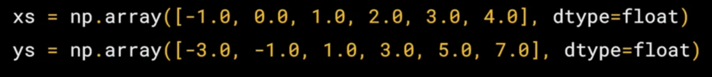
Building A single neuron Neural network - Continued
Our next step is to represent the known data. These are the Xs and the Ys that you saw earlier.
The np.array is using a Python library called numpy that makes data representation easier.
Here we have one list for the Xs and another one for the Ys.
The training takes place in the fit command. Here we're asking the model to figure out how to fit the X values to the Y values. The epochs equals 500 value means that it will go through the training loop 500 times.
This training loop is what I described earlier. Make a guess, measure how good or how bad the guesses with the loss function, then use the optimizer and the data to make another guess and repeat this.
When the model has finished training, it will then give you back values using the predict method. So it hasn't previously seen 10, and what do you think it will return when you pass it a 10? Why?
Notes:
Ultimately there are two main reasons why you don’t get an exact 19. The first is that you trained it using very little data. There's only six points.
Those six points are linear but there's no guarantee that for every X, the relationship will be Y equals 2X minus 1.
There's a very high probability that Y equals 19 for X equals 10, but the neural network isn't positive. So it will figure out a realistic value for Y.
That's the second main reason. When using neural networks, as they try to figure out the answers for everything, they deal in probability.
You'll see that a lot and you'll have to adjust how you handle answers to fit.

